Slide 1
Average Speed Assessment Name ______________
The formula d/t is used for calculating __________ and _____________.
What is a unit for speed? ____________
Some students were investigating the speed of a toy car they built. They performed
two trials and recorded their data in the table below.
What was the average speed of the toy car during the two trials to the nearest tenth of a
m/s? Be sure to use the correct place value. _______________
4. Which of the following best describes the velocity of an object?
A. 50 m/s
B. 50 m east
C. 50 m/s east
D. 50 m/s²
5. What is the difference between the velocity and the speed of an object?
A. Velocity is the change in distance over time, while speed is the change velocity over time.
B. Velocity has a direction associated with it, while speed has no specific direction.
C. Velocity has no direction associated with it, while speed has a specific direction.
D. Velocity is the change in speed over time, while speed is the change in distance over time.
A golf ball is hit a distance of 300 metres in 10 sec. What is the speed of the golf ball?
________________
Mr. Smith is traveling from Houston, TX to Dallas, TX. It takes 4 hours to make the 224
kilometre trip. What is his velocity? ___________
Trial 1 | Trial 1 | Trial 2 | Trial 2
Distance (m) | Time (sec) | Distance (m) | Time in (sec)
8.1 | 4 | 7.3 | 6

Slide 2
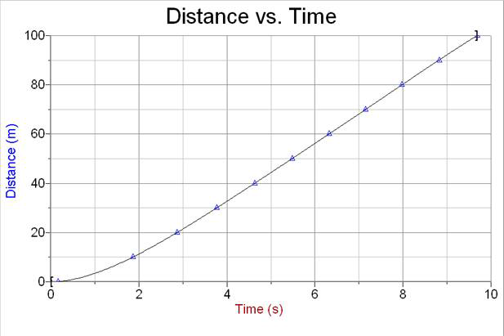
Average Speed Assessment Name ______________
8. What is the average speed of the object at 8 seconds? _____________
What are two ways an object can accelerate without speeding up?
____________________________________________________________________________________
____________________________________________________________________________________
____________________________________________________________________________________
____________________________________________________________________________________
Acceleration is measured in ______________ units.
Acceleration on a distance time graph shows up as a ________________ line.
Speed on a distance time graph shows up as a straight _______________ line.
No motion on a distance time graph shows up as a straight __________________ line.
14.-19. Give a definition and an example of each word.
Speed | Velocity | Acceleration

Slide 3
Average Speed Assessment Name ______________
Speed
Velocity
The formula d/t is used for calculating __________ and _____________.
What is the unit for speed? ____________
Some students were investigating the speed of a toy car they built. They performed
two trials and recorded their data in the table below.
What was the average speed of the toy car during the two trials to the nearest tenth of a
m/s? Be sure to use the correct place value. _______________
4. Which of the following best describes the velocity of an object?
A. 50 m/s
B. 50 m east
C. 50 m/s east
D. 50 m/s2
5. What is the difference between the velocity and the speed of an object?
A. Velocity is the change in distance over time, while speed is the change in velocity over time.
B. Velocity has a direction associated with it, while speed has no specific direction.
C .Velocity has no direction associated with it, while speed has a specific direction.
D. Velocity is the change in speed over time, while speed is the change in distance over time.
A golf ball is hit a distance of 300 yards in 10 sec. What is the speed of the golf ball?
________________
Mr. Smith is traveling from Houston, TX to Dallas, TX. It takes 4 hours to make the 224
mile trip. What is his velocity? ___________
m/s mph (answers may vary)
Trial 1 | Trial 1 | Trial 2 | Trial 2
Distance in m | Time in sec | Distance in m | Time in sec
8.1 | 4 | 7.3 | 6
1.5 m/s
30 yards/s
56 mph North or Northwest

Slide 4
Average Speed Assessment Name ______________
10 m/s
8. What is the average speed of the object at 8 seconds? _____________
What are two ways an object can accelerate without speeding up?
____________________________________________________________________________________
____________________________________________________________________________________
____________________________________________________________________________________
____________________________________________________________________________________
Acceleration is measured in ______________ units.
Acceleration on a distance time graph shows up as a __________ line.
Speed on a distance time graph shows up as a straight __________ line.
No motion on a distance time graph shows up as a straight __________ line.
14.-19. Give a definition and an example of each word.
The object can change direction.
The object can slow down
m/s²
curved
diagonal
horizontal
Speed | Velocity | Acceleration
Change in distance over a specific amount of time. A car moving at 60 mph. | Change in distance over a specific amount of time (speed) plus direction. A car moving at 60 mph east. | The change in velocity over a specific amount of time. Includes speeding up, slowing down or changing direction. A car accelerating at 60 m/s/s.

Slide 5
Average Speed Assessment Modified Name __________________
The formula d/t is used for calculating __________ and _____________.
A. Speed and acceleration
B. Speed and average speed
C. Speed and velocity
2. What is the unit for speed? ____________
A. m/s²
B. m/s
C. d/t
3. Which of the following best describes the velocity of an object?
A. 50 m/s
B. 50 m east
C. 50 m/s east
4. What is the difference between the velocity and the speed of an object?
A. Velocity is the change in distance over time, while speed is the velocity over
time.
B. Velocity has a direction associated with it, while speed has no specific
direction.
C. Velocity is the change in speed over time, while speed is the change
in distance over time.
5. Acceleration is measured in ______________ units.
A. m/s²
B. m/s
C. Mph
6. Acceleration on a distance time graph shows up as a __________ line.
A. Straight diagonal
B. Straight horizontal
C. Curved

Slide 6
Average Speed Assessment Modified Name _____________
7. Speed on a distance time graph shows up as a straight __________ line.
A. Straight diagonal
B. Straight horizontal
C. Straight vertical
8. No motion on a distance time graph shows up as a straight __________ line.
A. Straight diagonal
B. Straight horizontal
C. Straight vertical
9. Some students were investigating the speed of a toy car they built. They
performed two trials and recorded their data in the table below.
What was the average speed of the toy car during the two trials to the nearest
tenth of a m/s? Be sure to use the correct place value. _______________
A golf ball is hit a distance of 300 yards in 10 sec. What is the speed of the golf ball?
________________
Mr. Smith is traveling from Houston, TX to Dallas, TX. It takes 4 hours to make the 224
mile trip. What is his velocity? ___________
Trial 1 | Trial 1 | Trial 2 | Trial 2
Distance in m | Time in sec | Distance in m | Time in sec
8.1 | 4 | 7.5 | 6

